Slide 1

POLLUTION ABSORBTION DEVICE

Slide 2

Presented by BATCH No 10 D.PRAHARSHITHA (19R01A0421) K.HIMABINDU (19R01A0427) K.SAMHITHA (19R01A0429) M.SAI DEEPTHI (19R01A0433) K.SRIDHAR (19R01A0428) G.SESHU BABU (19R01A0424)

Slide 3
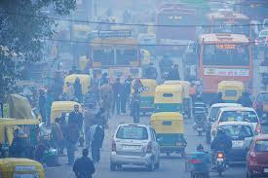
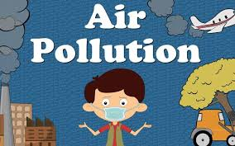
PROBLEM DEFINITION
Air pollution worldwide is a growing threat to human health and the natural environment.
Air pollution is contamination of atmosphere by liquids.
One of the main causes of air pollution is the release of carbon dioxide into the atmosphere, this happens because of deforestation and fossil fuel burning.
Sulfur dioxide is another poisonous gas which is responsible for acid rain.It is very dangerous to humans at a high concentration.

Slide 4

LITERATURE SURVEY
We were surveying about air pollution and its advese effects
The result were surprisingly very appropriate. The people we surveyed were aware of basics information of air polluti0n. they were in a opinion that city has become a concrete jungle. Pollution levels are rising day by day. Wearing pollution preventive masks has become a habit. They know that Delhi municipal corporate already launched device. They were interested in Public transport rather than private Vehicles. But they were unhappy with the govt that they were not taking any precautions and now our city also become future Delhi. They were expressing that the top most polluted cities were from india. This is irony of the situation.

Slide 5
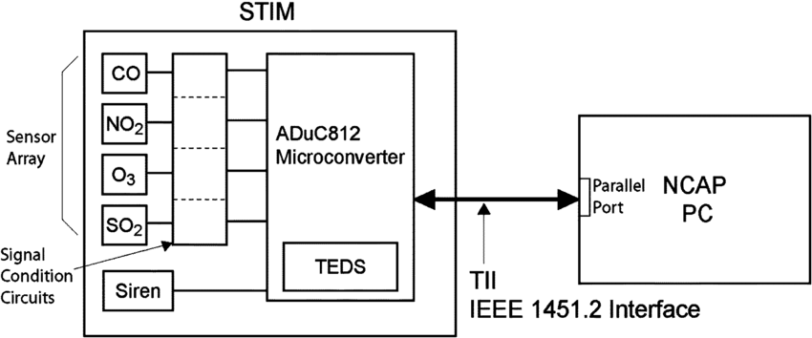
PROPOSED IDEA
Pollution has become the most hazardous problem in our society these days. So,we are planning to install a pollution absorbing device which will be absorbing the pollution causing gases. This device will be installed in the most polluted areas in the city.

Slide 6
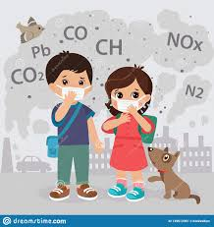
METHODOLOGY
The primary focus of air pollution regulation in industrialized countries has been on protecting ambient, or outdoor, air quality. This involves the control of a small number of specific “criteria” pollutants known to contribute to urban smog and chronic public health problems. The criteria pollutants include fine particulates, carbon monoxide, sulfur dioxide, nitrogen dioxide, ozone, and lead. Since the end of the 20th century, there also has been a recognition of the hazardous effects of trace amounts of many other air pollutants called “air toxics.” Most air toxics are organic chemicals, comprising molecules that contain carbon, hydrogen, and other atoms.there some absorbent and gas detecting sensor.

Slide 7
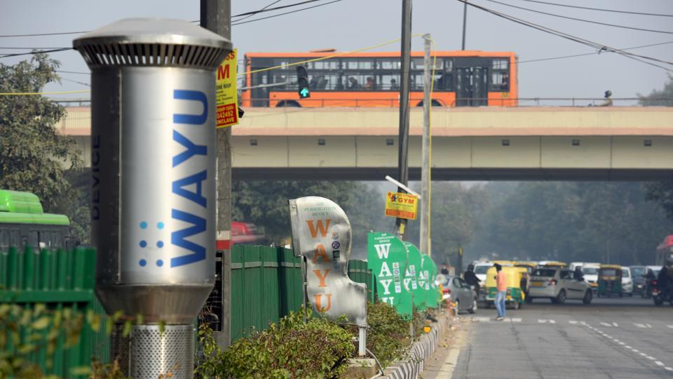
WORKING PRINCIPLE
The device works on two principles mainly wind generation for dilution of air pollutants and active pollutants removal. It has filters for particulate matter (PM) removal and activated carbon (charcoal) and UV lamps for poisonous gases removal such as Volatile organic compounds (VOCs) and Carbon Monoxide. It has one fan and filter for sucking and removing PM. It also has two UV lamps and half kg of activated carbon charcoal coated with special chemical Titanium Dioxide.

Slide 8
ADVANTAGES
It is economical
Air pollution can reduce by 40-60 percent
Gases stored in containers can be reused

Slide 9
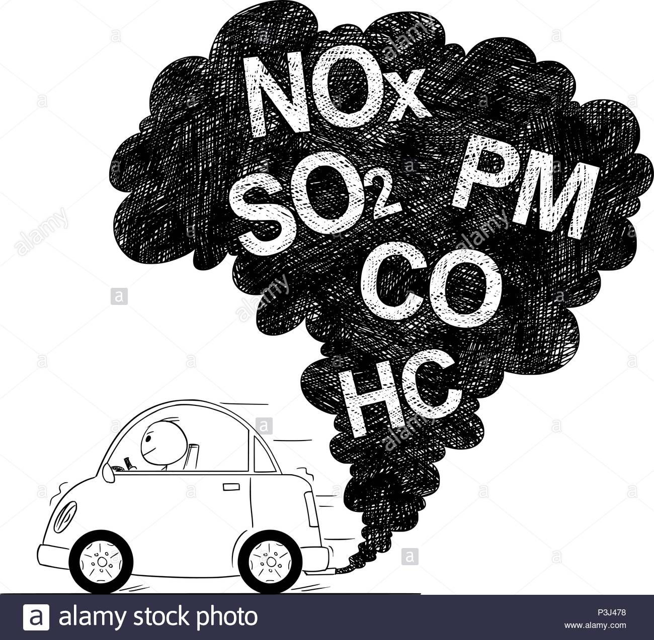
APPLICATIONS
Some type of air pollution control equipment or more of the methods of air pollution remove.
Scrubbers
Air filters
Cyclones
Electrostatic Precipitators
Mist Collectors
Incinerators
Catalytic Reactor
Biofilters

Slide 10

CONCLUSIONS
Air pollution can be prevented only if individuals and businesses stop using toxic substances that cause air pollution in the first place. This would require the cessation of all fossil fuel-burning processes, from industrial manufacturing to home use of air conditioners. This is an unlikely scenario at this time. However, we have to make rules which set stringent regulations on industrial and power supply manufacturing and handling. The regulations are to be designed to further reduce harmful emissions into the Earth's atmosphere

Slide 11



